Slide 1
Service-­Oriented Scientific Collaboration Social Network
Team - Xunrong Li, Teng Fu, Xiaofen Liu, Dacheng Wen

Slide 2
Roadmap
Introduction
Motivation
Related Work
System Design
System Implementation
Demo
Future Work

Slide 3
Introduction
This social network is designed to be used by the researchers in NASA to connect themselves to others.
A researcher is able to follow other researchers and be followed by others as well.
A researcher is able to publish a text post with or without current location, and also able to share others’ posts.
A post can be commented and liked.

Slide 4
Motivation
NASA needs a social network to be used internally as a way for the communication among the researchers in order to facilitate the development of scientific researches.

Slide 5


Related Work
Functionalities of popular social network
Like, Share, Comment, Private post
Following and unfollow
Search and autocomplete
Extra features (add France flag as extra layer)

Slide 6
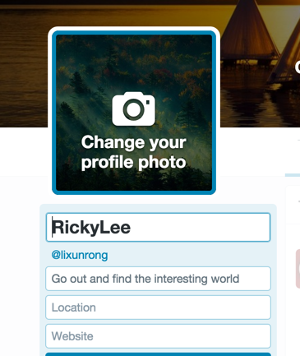
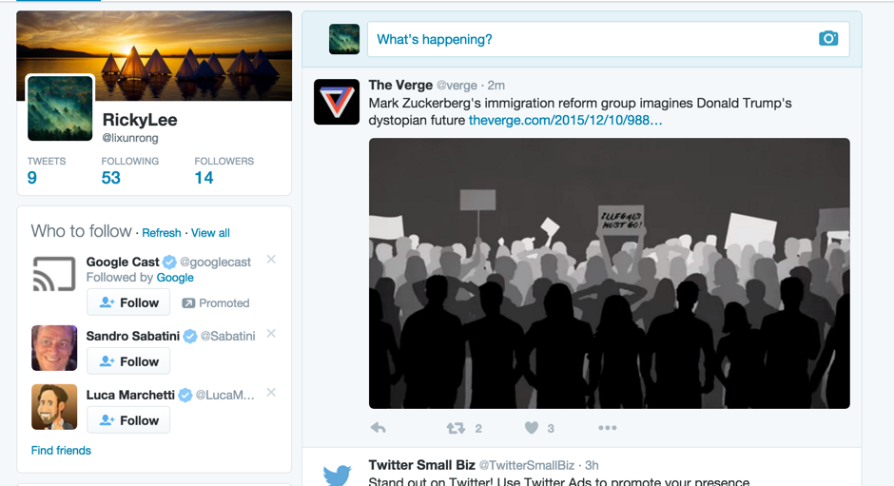
Related Work
Design and layout of popular social website

Slide 7






System Design

Slide 8
System Design
Frontend
Model
User, Post, Comment
View
index, login, signup, createSuccess, home, index, other, search, topPosts, etc
Controller
UserController, PostController, MainController

Slide 9
System Design
Backend
Model
User, Post, Comment
View
Empty since backend
Controller
UserController, PostController, CommentController

Slide 10
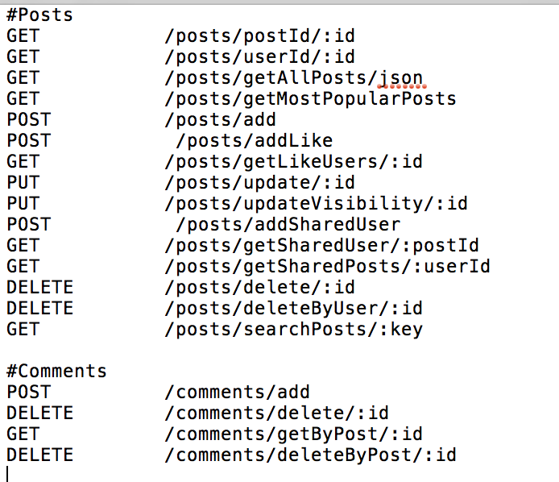
System Implementation

Slide 11
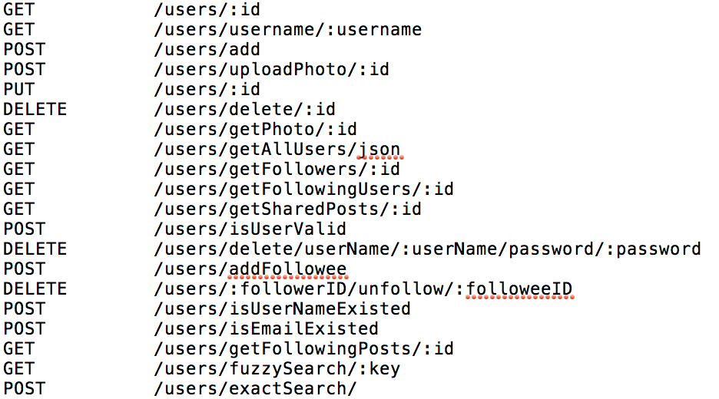
System Implementation

Slide 12
System Implementation
Many to Many Relationship
User following
Post sharing
Post liking

Slide 13
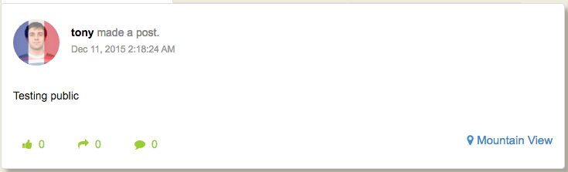
System Implementation
Additional Feature

Slide 14
Challenge
Stack overflow when converting object to JSON (Many to many).
Solution: Add annotation and Exclusion Strategy to avoid infinite loop.
Ajax: search posts without refreshing pages
Upload profile image from front-end directly
enable to CORS filter by setting Globals configuration

Slide 15
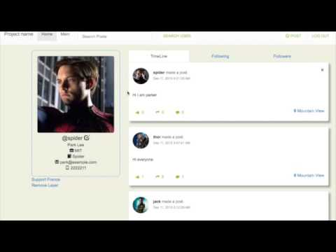
Demo

Slide 16
Future Work
More advanced features
Post photos, video, links and other media
Support @ function
Support new posts and new message notifications
Polished User Interface
Enable User to customize themes for their profile page
Unit tests & Integration Tests

Slide 17
Q&A

